Slide 1
Artificial Intelligence in Action
Owais Hussain

Slide 2
Contents
What is Artificial Intelligence?
Content generation
Translation
Search
Instruction generation
Auto tutoring
Entertainment

Slide 3
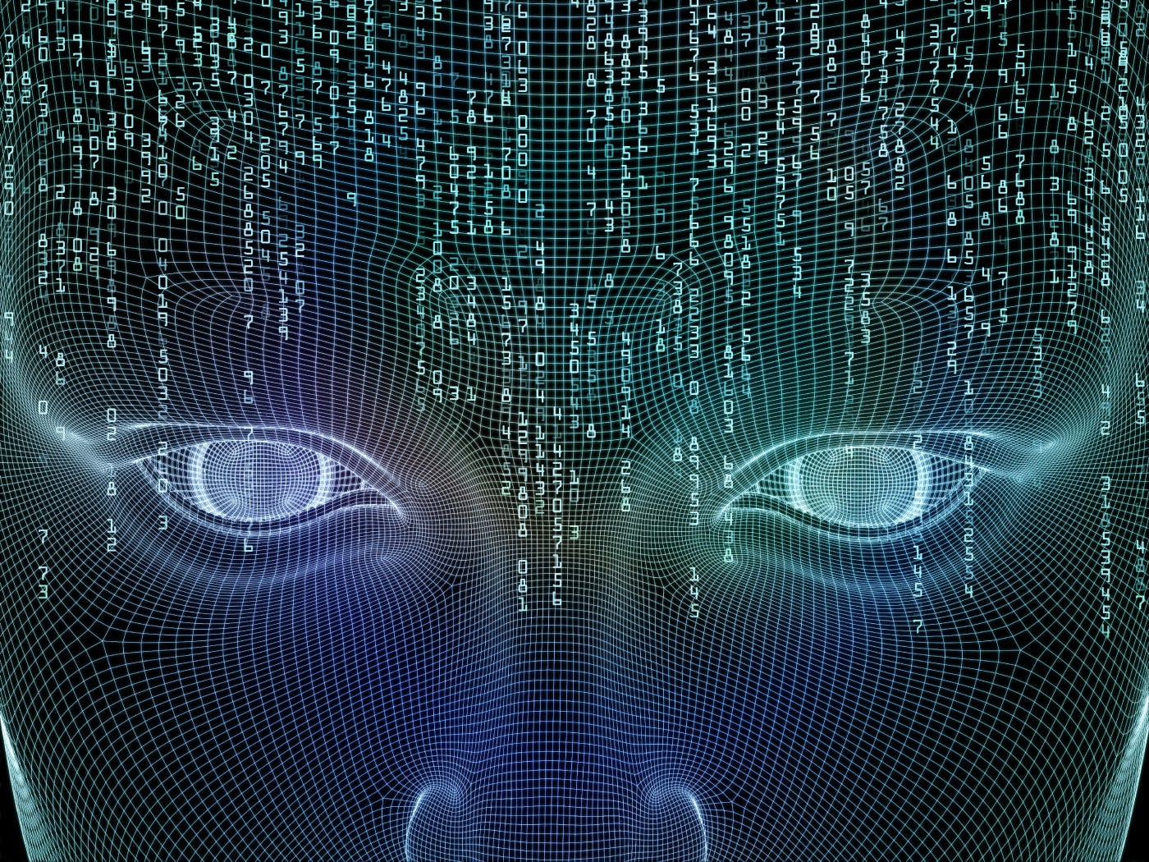

What is Artificial Intelligence?
Artificial Intelligence is the ability of a machine to think like a human.
At Present, AI:
is capable of mimicking humans in speech, decision making, pattern matching, object identification, problem solving.
cannot make original contributions.
cannot reason beyond its dataset.

Slide 4
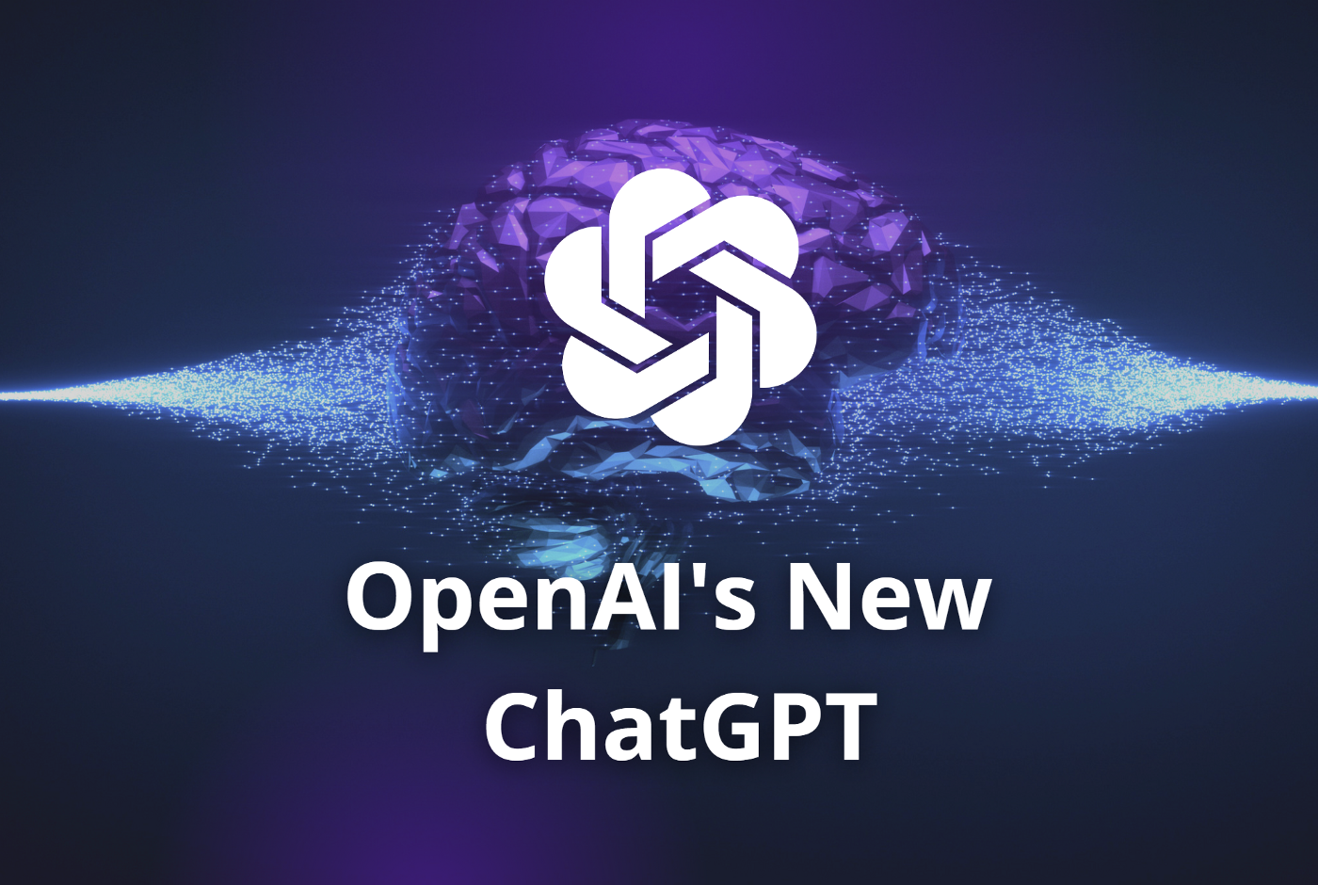
Content Generation
Text generation using ChatGPT
“Generate a bedtime story for my daughter that I can read to her in 15 minutes. The story should showcase Alladin’s friendship with Genie. She is 7 years old and already knows the base story.”

Slide 5
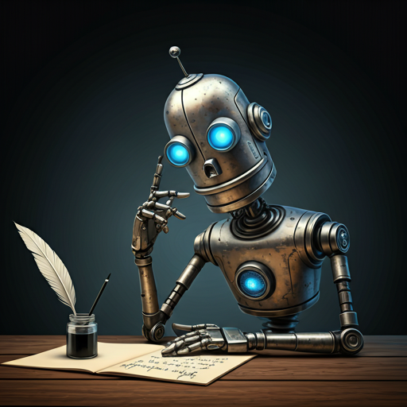
Content Generation
Poetry using Gemini
“Write me a poem to motivate young girls from Pakistan, highlight that they are an integral part of society and nation's future depends on them.”

Slide 6

Content Generation
Summary generation using Copilot
“Generate a summary of the famous book Who moved my cheese? The summary should be under 1000 words and use bullet points.”

Slide 7

Content Generation
Image generation using Dall-E
“Generate an image of a polar bear eating Donor kabab rolls in the Sahara Desert.”

Slide 8
Content Generation
Video generation using Sora
“Generate a realistic video depicting how pollution is devastating marine life.”

Slide 9
Content Generation
DIY:
Find a good AI voice changer and record a 15 second clip.

Slide 10
Translation
How would you translate this prescription in Urdu?
“Paracetamol 100ml every 6 hours for 5 days and 300ml Ibuprofen every alternate day after meals for 7 days.”
Using Dictionary:
پیراسیٹامول سو ملی لیٹر ہر چھ گھنٹے پانچ دن اور تین سو ملی لیٹر آئیبوپروفین ہر متبادل دن بعد کھانوں کے سات دن۔
Google Translate:
پیراسیٹامول 100 ملی لیٹر ہر 6 گھنٹے بعد 5 دن اور 300 ملی لیٹر آئبوپروفین ہر متبادل دن کھانے کے بعد 7 دن۔
ChatGPT:
پیرسٹا مول 100 ملی لیٹر ہر 6 گھنٹے کے بعد 5 دن تک استعمال کریں اور آئیبوپروفین 300 ملی لیٹر ہر دوسرے دن کھانے کے بعد 7 دن تک استعمال کریں۔
Notes:
Highlight how significant the impact can be in such cases if the translation does not reflect the intended meaning.

Slide 11
Search
Traditional search engines are still fast and effective.
Not for every case.
Search query:
“list of books on Machine learning taught at Ivy league institutes to undergraduate students”
Try Google and Bing search
Search for list of Ivy league institutes.
For each of these institutes you need a list of books taught.
Filter out books on Machine learning.
Keep the ones taught only in undergraduate programs.
Now try ChatGPT
AI-based search is better when context impacts search results.

Slide 12
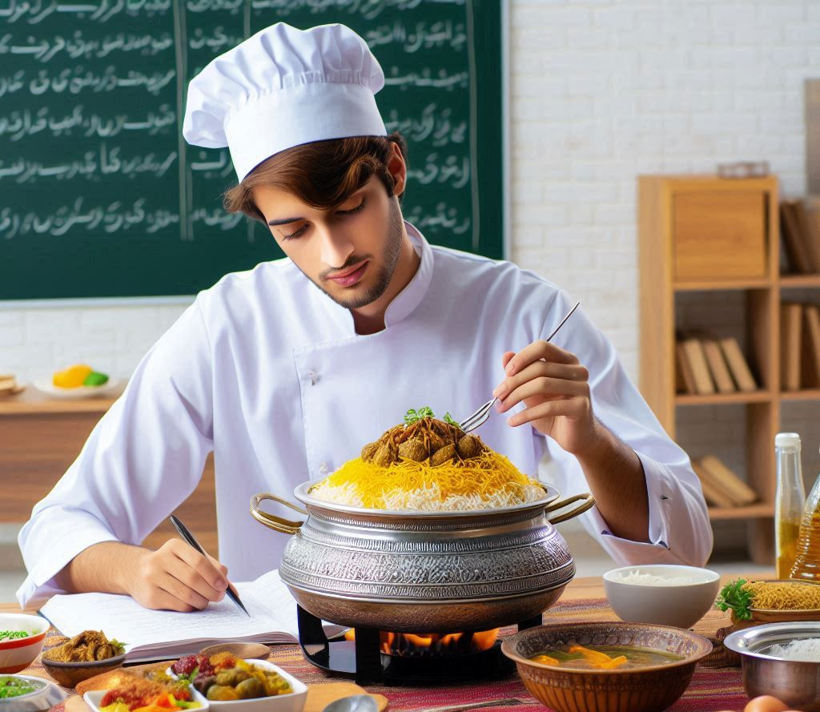
Instruction Generation
Who wouldn’t love authentic Hyderabadi Biryani?! But you need a recipe
YouTube:
Difficult to find authentic recipe in English
Cannot use alternate ingredients
Google:
Can only be used as-is
No further explanation if you get stuck
Now try ChatGPT:
“Give me a recipe for authentic Hyderabadi Biryani. Write Urdu translation of ingredients in brackets. Include tips for beginners.”

Slide 13
Auto Tutoring
Interactive
Personalized
Instant feedback
Self-paced
Examples:
Teach me how to solve quadratic equations step by step
Teach me how to write a program in Python to generate a series of Prime numbers
Create a quiz composed of 10 MCQs on the battel of Panipat
Help me write a persuasive letter to the dean on enabling 24/7 access to AI labs.
DIY: generate a 10-day course on improving Cultural Intelligence. (I highly recommend using Deepseek R1 for this)

Slide 14
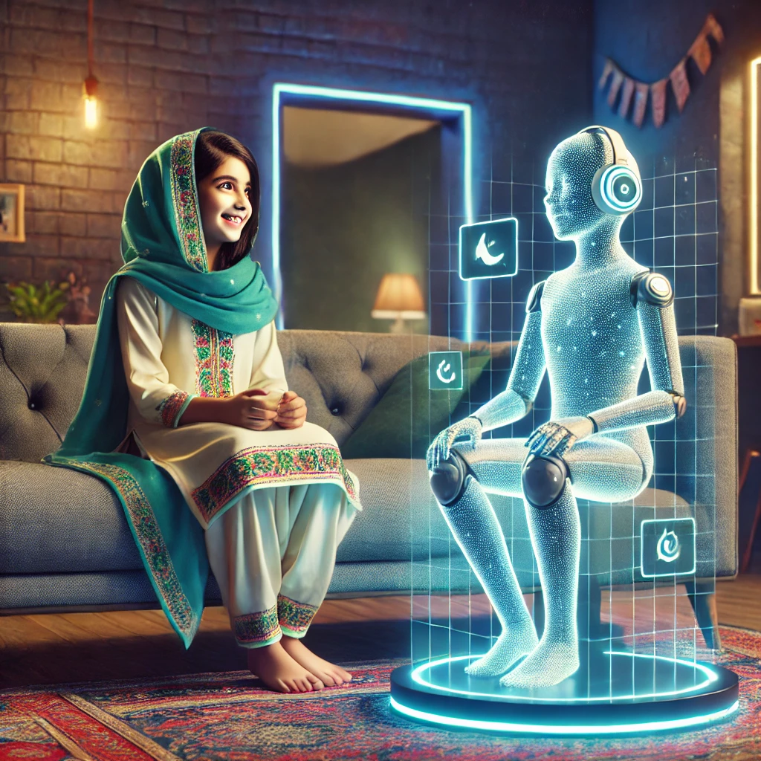
Entertainment
Playing Kasoti with ChatGPT with the following rules:
I will think of something or someone popular.
You have 20 questions to guess the name.
I will answer only with Yes, No or Maybe.
If my answer is Maybe, the question does not count.
Keep count of my questions.
Once you mention the name, the game ends and you win if the name is correct, otherwise you lose.
If you are unable to guess after 20 questions, you lose.

Slide 15
That’s it!
Hang on to these slides, they’ll help you in the breakout session.
We hope this presentation gave you a good flavour of Machine Intelligence and you’re already planning to make full use of these tools for self-improvement and learning.
Questions?

